Slide 1
PowerPoint slides to accompany…
Functional Behavioral
Assessment, Diagnosis,
and Treatment
A Complete System for Education and Mental Health Settings
Third Edition
Ennio Cipani, PhD
ISBN: 978-0-8261-7031-6

Slide 2
Copyright © 2018 Springer Publishing Company, LLC
All rights reserved.
This work is protected by U.S. Copyright laws. No part of this publication may be reproduced, stored in a retrieval system, or transmitted in any form or by any means, electronic, mechanical, photocopying, recording, or otherwise, without the prior permission of Springer Publishing Company, LLC, except for educational purposes. Dissemination or sale of any part of this work is not permitted.
Springer Publishing Company, LLC
11 West 42nd Street
New York, NY 10036
www.springerpub.com
ISBN: 978-0-8261-7031-6
The author and the publisher of this Work have made every effort to use sources believed to be reliable to provide information that is accurate and compatible with the standards generally accepted at the time of publication. The author and publisher shall not be liable for any special, consequential, or exemplary damages resulting, in whole or in part, from the readers’ use of, or reliance on, the information contained in this book. The publisher has no responsibility for the persistence or accuracy of URLs for external or third-party Internet websites referred to in this publication and does not guarantee that any content on such websites is, or will remain, accurate or appropriate.

Slide 3
Is It ADHD?
Let’s look at two hypothetical students,
both diagnosed with attention deficit hyperactivity disorder (ADHD)
and similar baseline rates of performance
during repeated 1 hour classroom observation (math period)

Slide 4
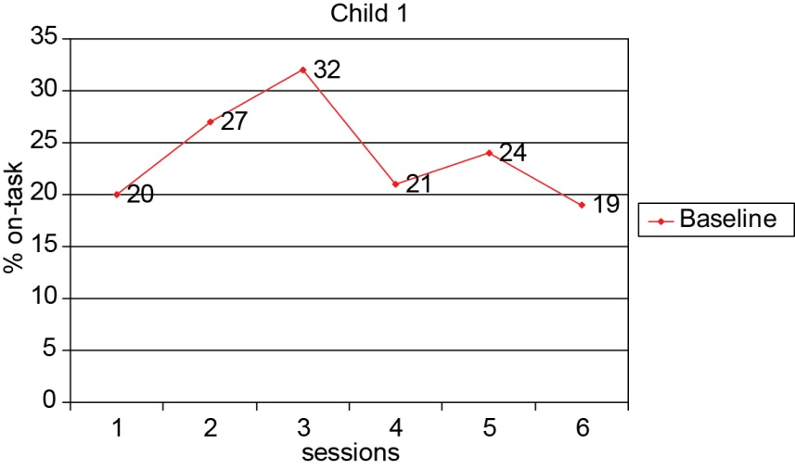

Slide 5
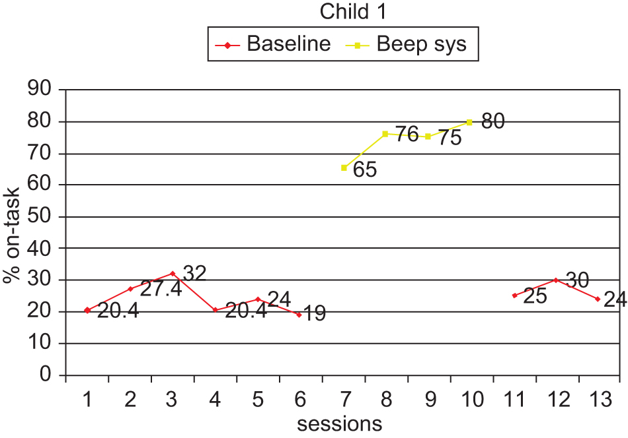

Slide 6
What does that show?
Child 1 on-task behavior is indicative of a misdirected contingency
Low operant rate under baseline conditions
Dramatic and immediate improvement with stipulation (and imposition) of contingency
Inattention not a repertoire deficit!

Slide 7
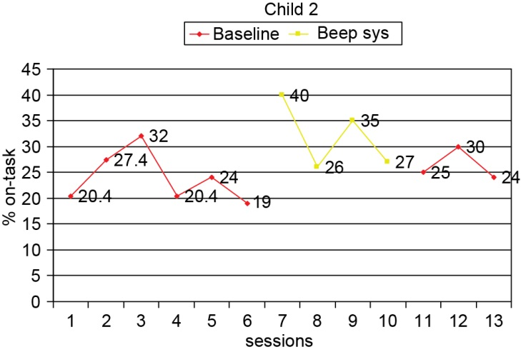

Slide 8
What does that show?
Child 2 on-task behavior is indicative of an inept repertoire diagnosis
Low operant rate under baseline conditions
Little improvement with stipulation (and imposition) of contingency
Unable to turn behavior on and off with a simple contingency quickly (not discounting the possibility that dimension shaping would eventually be effective after repeated sessions)

